Slide 1
SPATIAL DBMS- Understanding
A DBMS designed to store and query spatial data
-vector objects, raster objects, and networks.
To handle spatial data we need Object Relational DBMS (ORDBMS).
In ORDBMS Abstract Data Types (ADTs) (user defined data types) can be managed.
As spatial data is saved SDBMS need Spatial query language equipped with spatial operations and spatial indexing so query optimization.

Slide 2
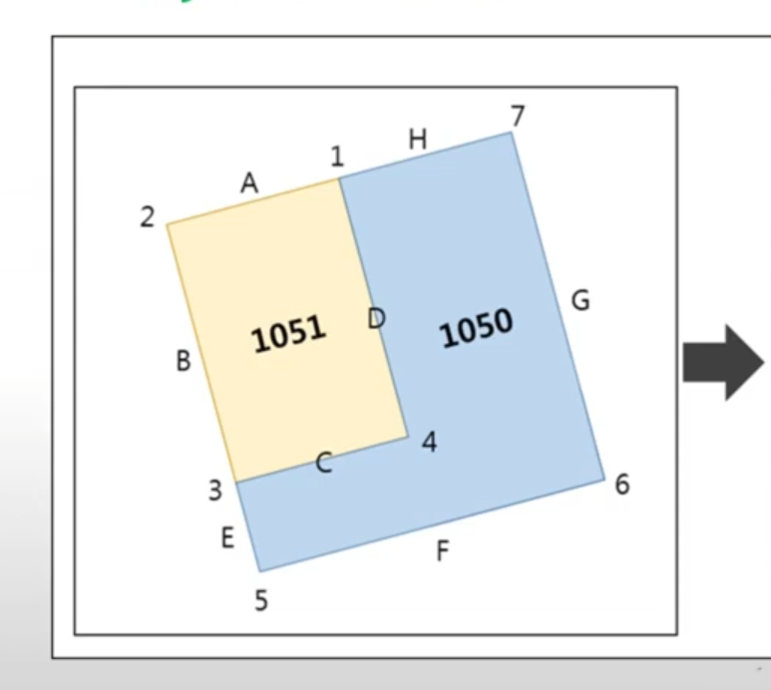
RDBMS is Inefficient for spatial data
PARCLE
Polygon ID | Area | Population | Name
1050 | 3500 | 1839 | Area 1
1051 | 2900 | 1233 | Area 2
POLYGON
EDGE
POINT
Polygon ID | EDGE
1051 | A
1051 | B
1051 | C
_ | _
EDGE ID | END POINT
A | 1
A | 2
B | 2
B | 3
_ | _
EDGE ID | X | Y
A | 0.5 | 3
A | -1 | 2
B | 0 | 0
B | 1 | 1
_ | _ | _
Here, we cannot defined any SRID. According to rectangular coordinate system the points are defined and SQL join operators are used for joining table & design of cadastral system as shown in fig.

Slide 3
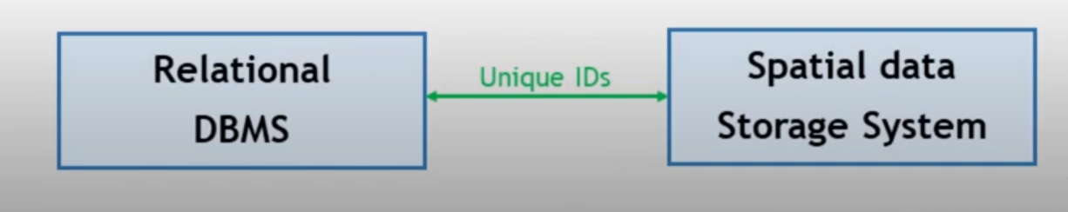
DEALING WITH SPATIAL DATA
The Dual Architecture
Used before establishment of ORDBMS
A separate file system is used for spatial data while RDBMS only manage attribute data.
Both system work together for the functioning of spatial data.
It overcome inefficiency but cannot include required powerful database feature i.e transaction measurements. And used for single user application.

Slide 4
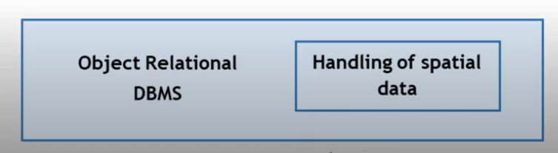
DEALING WITH SPATIAL DATA
Integrated Architecture
After Establishment of ORDBMS dealing with ADTs, spatial data could be integrated with DBMS.
Column can be of point, line and polygon and support full functionality of DBMS
PostgreSQL, ArcSDE, Oracle Spatial, Geo++, etc…

Slide 5
Object Relational DBMS (ORDBMS)
Object- oriented programming method supports user-defined type, a class definition with a structure and method
Relational DBMS supports queries and DBMS features.
ORDBMS present both complex data handling and full functionality of DBMS .
PostgreSQL is an ORDBMS, and PostGIS is an extension with spatial data types (complex data) and spatial operations.

Slide 6
Spatial Data can be handled with:
PostgreSQL with PostGIS Oracle Spatial and Graph
MYSQL with Spatial extension Microsoft SQL Server with Spatial Data
MongoDB with GeoJSON SpatialLite (SQLite with spatial Extension)
For most GIS and spatial data applications, PostgreSQL with PostGIS is the best option due to its powerful features, community support and ability to handle complex spatial queries effectively

Slide 7
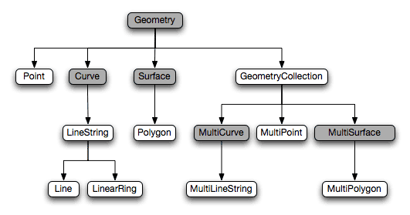
Spatial Data Types
-

Slide 8
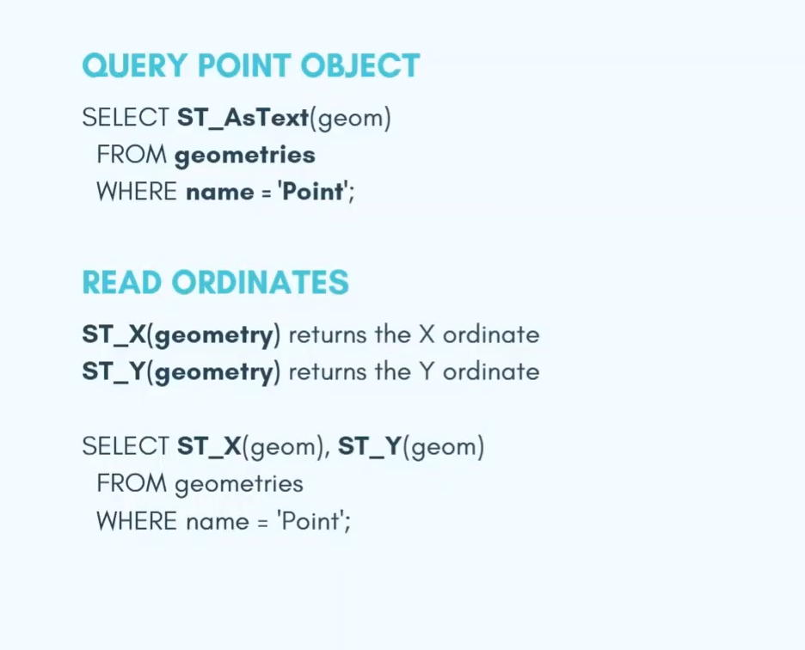
POINTS

Slide 9
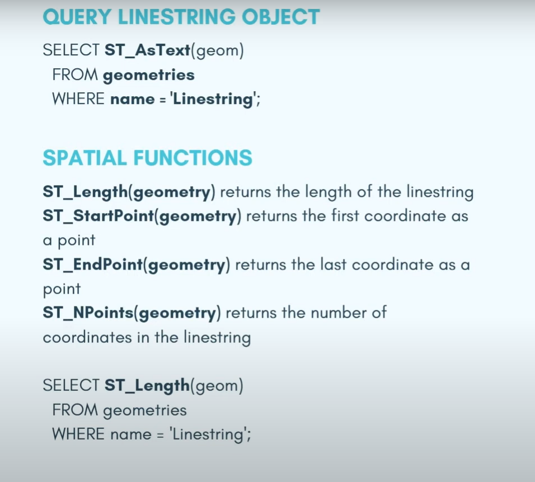
LINESTRINGS
-

Slide 10
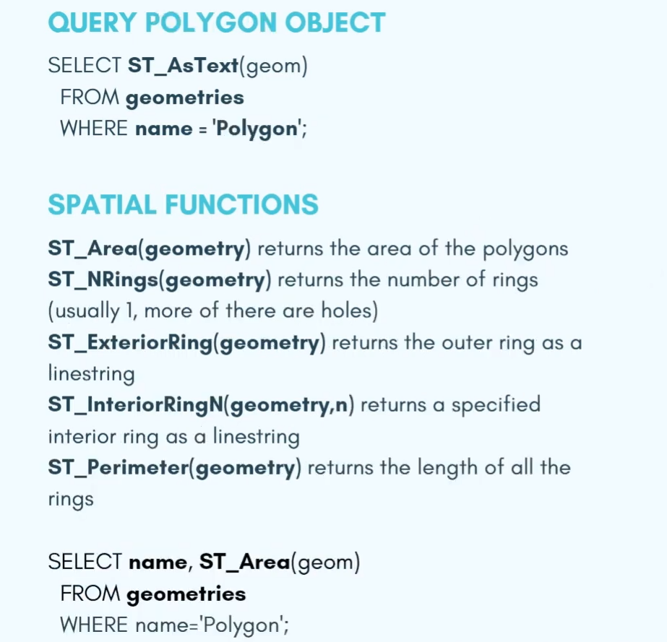
POLYGONS
-

Slide 11
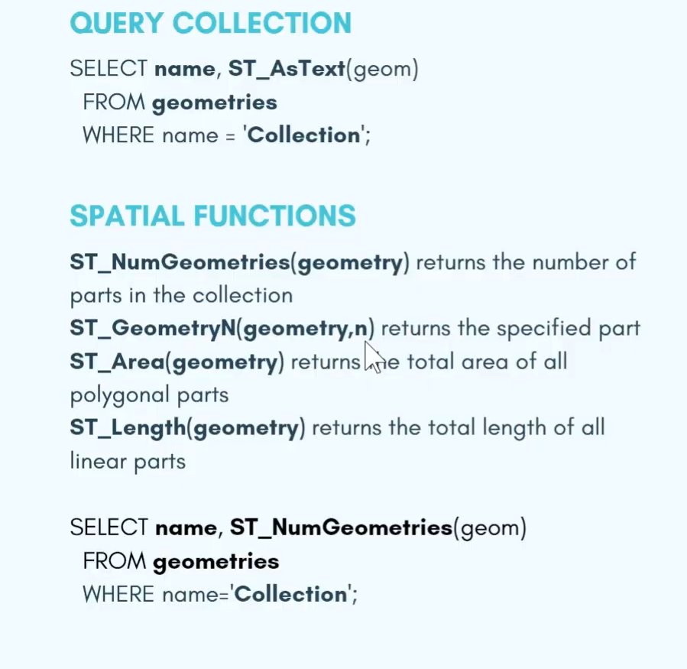
COLLECTION
-

Slide 12
Spatial Queries
- 1. Basic Spatial Queries
Point-in-Polygon Query: Checks if a point is within a polygon.
Within: Determines if one geometry is within another.
Contains: Checks if one geometry contains another.
Intersects: Finds geometries that intersect with a given geometry.
Touches: Determines if two geometries share a boundary point without overlapping.
Crosses: Checks if geometries cross each other (e.g., lines crossing polygons).
Overlaps: Checks if geometries overlap each other.

Slide 13
Spatial Queries
2. Distance and Proximity Queries
ST_Distance: Measures the minimum distance between two geometries.
ST_DWithin: Checks if two geometries are within a specified distance.
ST_Buffer: Creates a buffer around a geometry at a specified distance.
3. Spatial Joins
ST_Intersects: Used in a join to find geometries that intersect.
ST_Within Join: Joins two tables where one geometry is within another.
ST_Contains Join: Joins based on one geometry containing another.
4. Geometric Operations
ST_Union: Combines multiple geometries into one.
ST_Intersection: Finds the common area between geometries.
ST_Difference: Finds the area of one geometry that is not shared with another.
ST_SymDifference: Finds the symmetric difference between two geometries.

Slide 14
Spatial Queries
5. Measurement and Calculation Queries
ST_Area: Calculates the area of a polygon.
ST_Length: Computes the length of a line or perimeter of a polygon.
ST_Perimeter: Measures the perimeter of a polygon.
ST_Centroid: Finds the centroid (geometric center) of a geometry.
6. Modification and Transformation
ST_Translate: Moves a geometry by a specified distance.
ST_Rotate: Rotates a geometry around a point.
ST_Scale: Scales a geometry by a specified factor.
ST_Affine: Applies a matrix transformation to a geometry.
7. Topological Queries
ST_Relate: Tests for a specified spatial relationship between two geometries using DE-9IM (Dimensionally Extended 9-Intersection Model).
ST_Touches: Tests if two geometries touch at the boundary but do not overlap.

Slide 15
Spatial Queries
8. Raster Queries (specific to raster data)
ST_Value: Retrieves the value of a raster cell.
ST_AsRaster: Converts a geometry to raster format.
ST_Clip: Clips raster data to a specified geometry.
9. Indexing and Optimization
Spatial Index Queries: Using spatial indices (like R-trees) to optimize spatial queries.

Slide 16
THANK YOU

